Slide 1
LEARNING STYLES
ALLIGNED WITH
PERSONALITY TYPES

Slide 2
Carl G. Jung
PERSONALITY TYPES
“I can improve my interpersonal relationships, realign my expectations towards others, and gain a better self-knowledge that will help me define and achieve goals.”

Slide 3
FOUR PREFERENCES
Dependence on activity
  Extroverts - Introverts
Perceiving the information and data
  Sensing - Intuitive
Making decisions from information and data
  Thinking - Feeling
Attitude toward received information and data
  Judging - Perceiving

Slide 4
Dependent on activity
EXTRAVERT
Talk
Listen to what someone is saying
Actively participate
Cook dinner, or make a cup of coffee
Introverts
Read
Think before speaking
Aware of feelings
Think through a problem so that you understand it

Slide 5
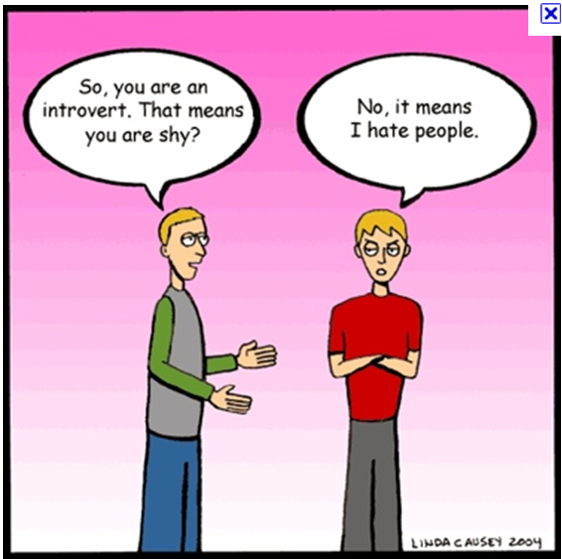
*** Important distinction is which world we live in more often.

Slide 6
Perceive the information
SENSES
Taste food
Notice a stoplight changing
Memorize a speech
Follow steps in a plan (Literal and concrete)
INTUITIVE
Find new way to do things
Think about future implications
Perceive underlying meaning
See the big picture (Abstract)
Notes:
Refers to how we gather information through our five senses
Two distinct ways of perceiving the data that we gather
"Sensing" preference absorbs data in a literal, concrete fashion
"Intuitive" preference generates abstract possibilities from information that is gathered

Slide 7
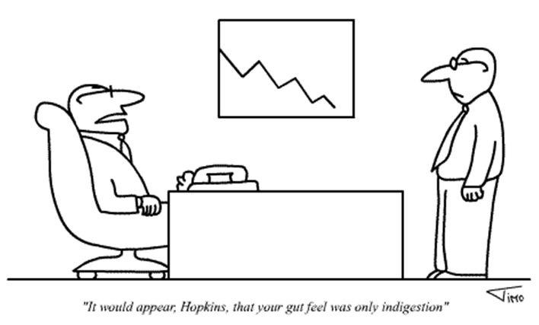
** Important distinction is which method of gathering information do we trust the most

Slide 8
DECISION- MAKING
FROM INFORMATION
THINKER
Decision - rational, logical, impartial (pre-defined rules)
Do "The Right Thing", whether or not we like it
Establish guidelines to follow
Buy something because it is in our budget
FEELER
Decisions on individual case in a subjective manner (right within their own value systems)
Refrain from telling something that may upset someone
Do not take a job because of poor work environment
Buy something because we like it
Notes:
People have the capability to make decisions based on two very different sets of criteria
When someone makes a decision that is based on logic and reason, they are operating in THINKING mode.
When someone makes a decision that is based on their value system, or what they believe to be right, they are operating in FEELING mode.
Some decisions are made entirely by Thinking or Feeling processes.
Most decisions involve some Thinking and some Feeling.
Decisions that we find most difficult are those in which we have conflicts between our Thinking and Feeling sides; our dominant preference will take over.
Decisions which we find easy to make and feel good about are usually a result of being in sync with both our Feeling and Thinking sides.

Slide 9
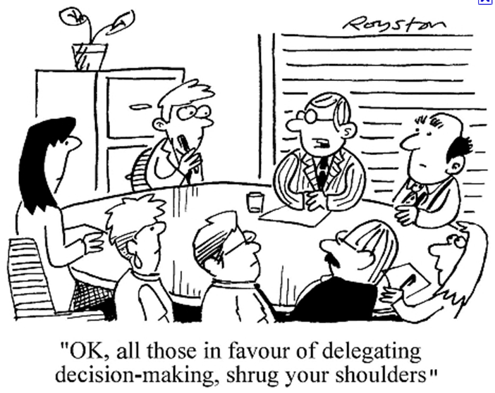
**Important distinction is which way of life do we lean towards, and are more comfortable with

Slide 10
ATTITUDE TOWARD INFORMATION
JUDGING
Want things settled (bring closure)
Make a list
Schedule things in advance
Form and express judgments
PERCEIVING
Want things open-ended
Act spontaneously; (decide on the spot)
Postpone decisions for other options
Do things at the last minute
Notes:
Our attitude towards the external world, and how we live our lives on a day-to-day basis
Judging preference want things to be neat, orderly and established
Perceiving preference wants things to be flexible and spontaneous
People with strong Judging preferences might have a hard time accepting people with strong Perceiving preferences, and vice-versa.
A "mixed" couple (one Perceiving and one Judging) can complement each other very well, if they have developed themselves enough to be able to accept each other's differences.

Slide 11
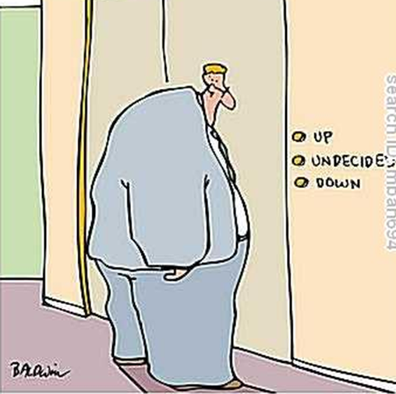

Slide 12
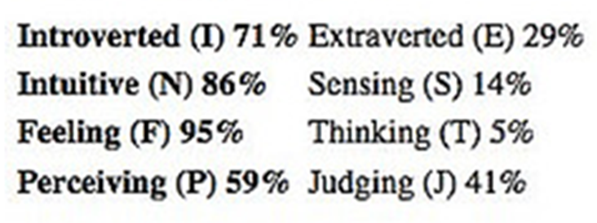
Complete Survey
Share our preference.
What do you have incommon?

Slide 13
Short-hand designations for 16 Personality Types
ENTJ, INFP, ISTJ, ENFJ ……………..
Order and organization to letter codes
    Perceiving Functions
    Judging Functions

Slide 14
Middle two letters deal with mental functions
  Two categories:
    2nd letter >> the preferred means of perceiving
      Sensing or Intuition
    3rd letter >> the preferred means of judging
      Thinking or Feeling

Slide 15
  Find your personality type and review the description.

Slide 16
Let’s compare our preferences.
  What type of learning activities do you prefer?
  What type of assessments do you prefer?
  Others?
3 Learning activities | 3 Types of assessments

Slide 17
I S T J
Serious and quiet, interested in security and peaceful living.
Extremely thorough, responsible, and dependable.
Well-developed powers of concentration.
Usually interested in supporting and promoting traditions and establishments.
Well-organized and hard working towards identified goals.
Usually accomplish any task once they have set their mind to it.

Slide 18
I S T P
Quiet and reserved, interested in how and why things work.
Excellent skills with mechanical things.
Risk-takers who they live for the moment.
Usually interested in and talented at extreme sports.
Uncomplicated in their desires.
Loyal to their peers and to their internal value systems, but not overly concerned with respecting laws and rules if they get in the way of getting something done.
Detached and analytical, they excel at finding solutions to practical problems.

Slide 19
I SFJ
Quiet, kind, and conscientious.
Usually puts the needs of others above their own needs.
Stable and practical, value security and traditions.
Well-developed sense of space and function.
Rich inner world of observations about people.
Extremely perceptive of other's feelings. Interested in serving others.

Slide 20
I S F P
Quiet, serious, sensitive and kind.
Do not like conflict, and not likely to do things which may generate conflict.
Loyal and faithful.
Extremely well-developed senses, and aesthetic appreciation for beauty.
Not interested in leading or controlling others. Flexible and open-minded.
Likely to be original and creative. Enjoy the present moment.

Slide 21
I N F J
Quietly forceful, original, and sensitive.
Tend to stick to things until they are done.
Extremely intuitive about people, and concerned for their feelings.
Well-developed value systems which they strictly adhere to.
Well-respected for their perseverance in doing the right thing.
Likely to be individualistic, rather than leading or following.

Slide 22
I N F P
Quiet, reflective, and idealistic. Interested in serving humanity.
Well-developed value system, which they strive to live in accordance with.
Extremely loyal.
Adaptable and laid-back unless a strongly-held value is threatened.
Usually talented writers. Mentally quick, and able to see possibilities.
Interested in understanding and helping people.

Slide 23
I N T J
Independent, original, analytical, and determined.
Exceptional ability to turn theories into solid plans of action.
Highly value knowledge, competence, and structure; very high standards for their performance, and the performance of others.
Driven to derive meaning from their visions.
Long-range thinkers.
Natural leaders, but will follow if they trust existing leaders.

Slide 24
I N T P
Logical, original, creative thinkers.
Can become very excited about theories and ideas. Exceptionally capable and driven to turn theories into clear understandings.
Highly value knowledge, competence and logic.
Quiet and reserved, hard to get to know well.
Individualistic, having no interest in leading or following others.

Slide 25
E S T P
Friendly, adaptable, action-oriented.
"Doers" who are focused on immediate results.
Living in the here-and-now, they're risk-takers who live fast-paced lifestyles.
Impatient with long explanations.
Extremely loyal to their peers, but not usually respectful of laws and rules if they get in the way of getting things done.
Great people skills.

Slide 26
E S T J
Practical, traditional, and organized.
Likely to be athletic.
Not interested in theory or abstraction unless they see the practical application.
Have clear visions of the way things should be.
Loyal and hard-working.
Like to be in charge. Exceptionally capable in organizing and running activities.
"Good citizens" who value security and peaceful living.

Slide 27
E S F P
People-oriented and fun-loving, make things more fun for others by their enjoyment.
Living for the moment; love new experiences.
Dislike theory and impersonal analysis.
Interested in serving others.
Likely to be the center of attention in social situations.
Well-developed common sense and practical ability.

Slide 28
E S F J
Warm-hearted, popular, and conscientious.
Tend to put the needs of others over their own needs.
Feel strong sense of responsibility and duty.
Value traditions and security.
Interested in serving others.
Need positive reinforcement to feel good about themselves.
Well-developed sense of space and function.

Slide 29
E N F P
Enthusiastic, idealistic, and creative.
Able to do almost anything that interests them.
Great people skills.
Need to live life in accordance with their inner values.
Excited by new ideas, but bored with details.
Open-minded and flexible, with a broad range of interests and abilities.

Slide 30
E N F J
Popular and sensitive, with outstanding people skills.
Externally focused, with real concern for how others think and feel.
Usually dislike being alone; see everything from the human angle, and dislike impersonal analysis.
Very effective at managing people issues, and leading group discussions.
Interested in serving others, and probably place the needs of others over their own needs.

Slide 31
E N T P
Creative, resourceful, and intellectually quick.
Good at a broad range of things.
Enjoy debating issues; may be into "one-up-manship".
Very excited about new ideas and projects, but may neglect the more routine aspects of life.
Generally outspoken and assertive.
Enjoy people and are stimulating company.
Excellent ability to understand concepts and apply logic to find solutions.

Slide 32
E N T J
Assertive and outspoken - driven to lead.
Excellent ability to understand difficult organizational problems and create solid solutions.
Intelligent and well-informed; usually excel at public speaking.
Value knowledge and competence, and usually have little patience with inefficiency or disorganization.

